Slide 1


Jeopardy Game
By Brian Dobbs,
Ivan Valdez,
Samuel Siaw

Slide 2
User Statement
We had made a jeopardy game that let users to register and login in. There are two teams that will choose questions and answer them.
When clicking the question it will show a pop up and when moving around the mouse around the question it will highlight the answer. The game gives the user the power to give themselves points.
Questions will be from multiple Web Programing concepts will keep them learning.

Slide 3
Overview
We will create a jeopardy game by using the following
We made a homepage, signup page, login page, game screen page, game question
The game screen will display topics and score for each question
Homepage will display login or the signup page
Game question display a question
Game page will also keep up with the score of each team
The game screen will go to a different page for the user can answer the question that was given

Slide 4
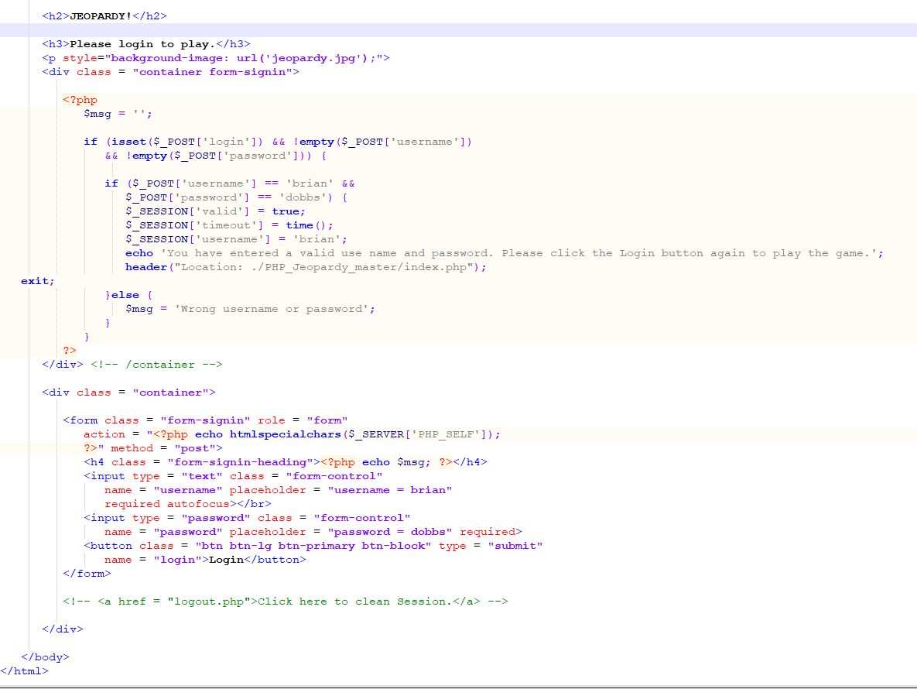
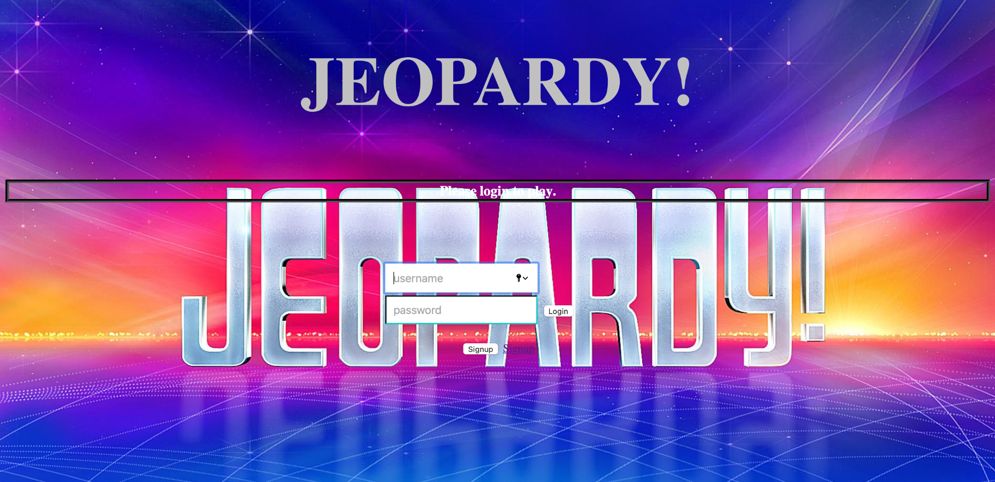
Login

Slide 5
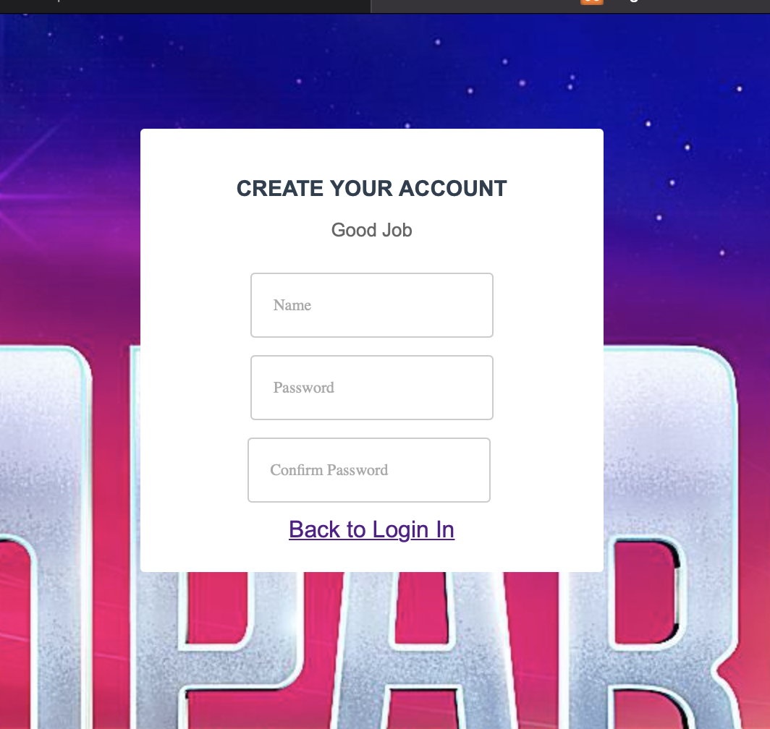
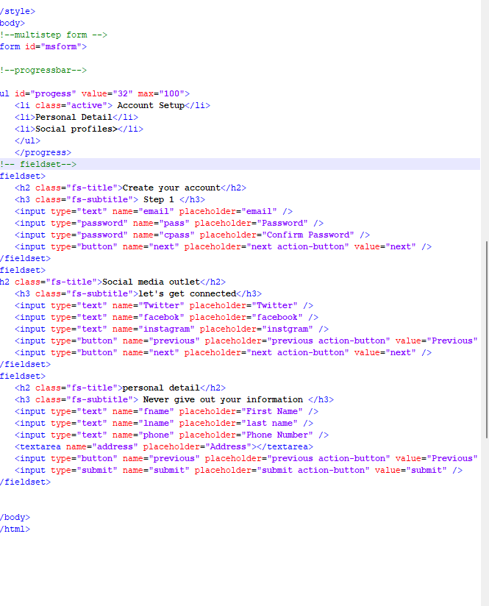
Sign-Ups

Slide 6
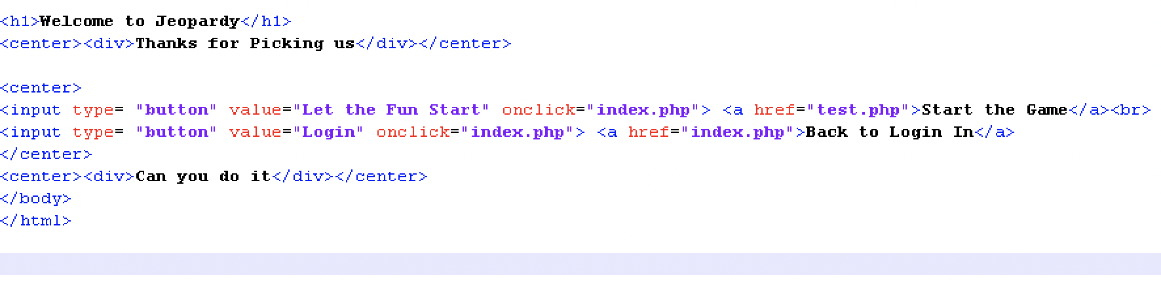
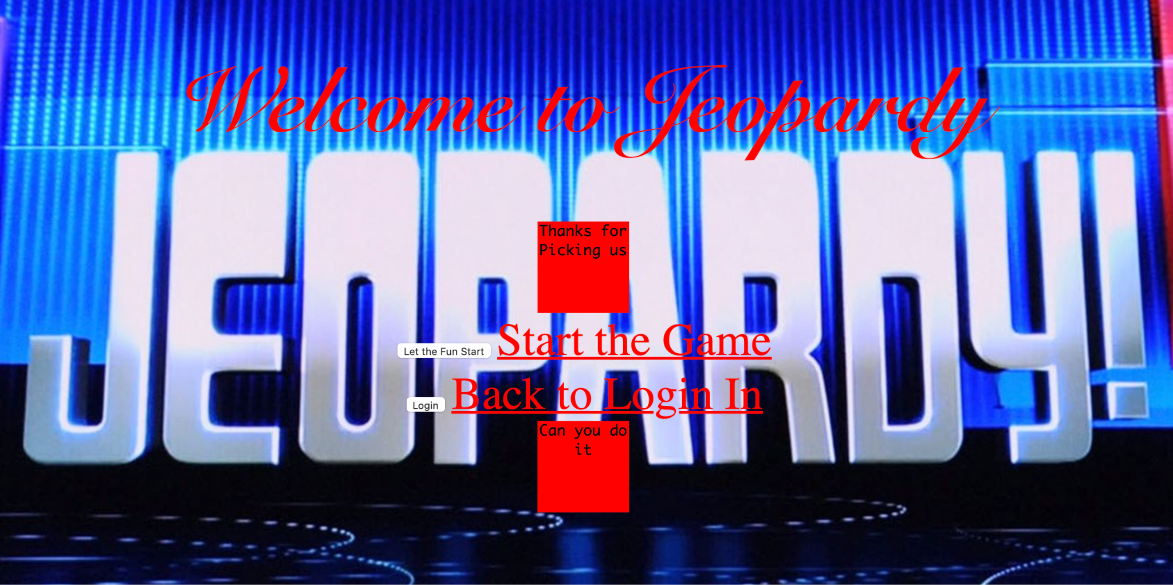
Welcome

Slide 7
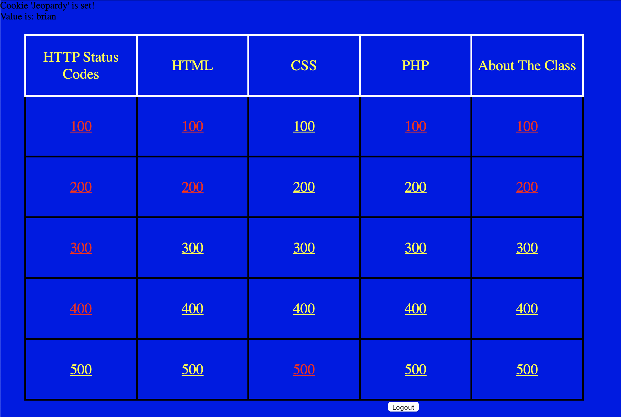
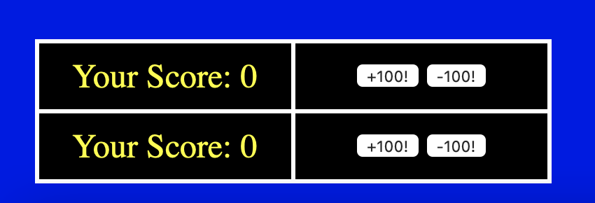
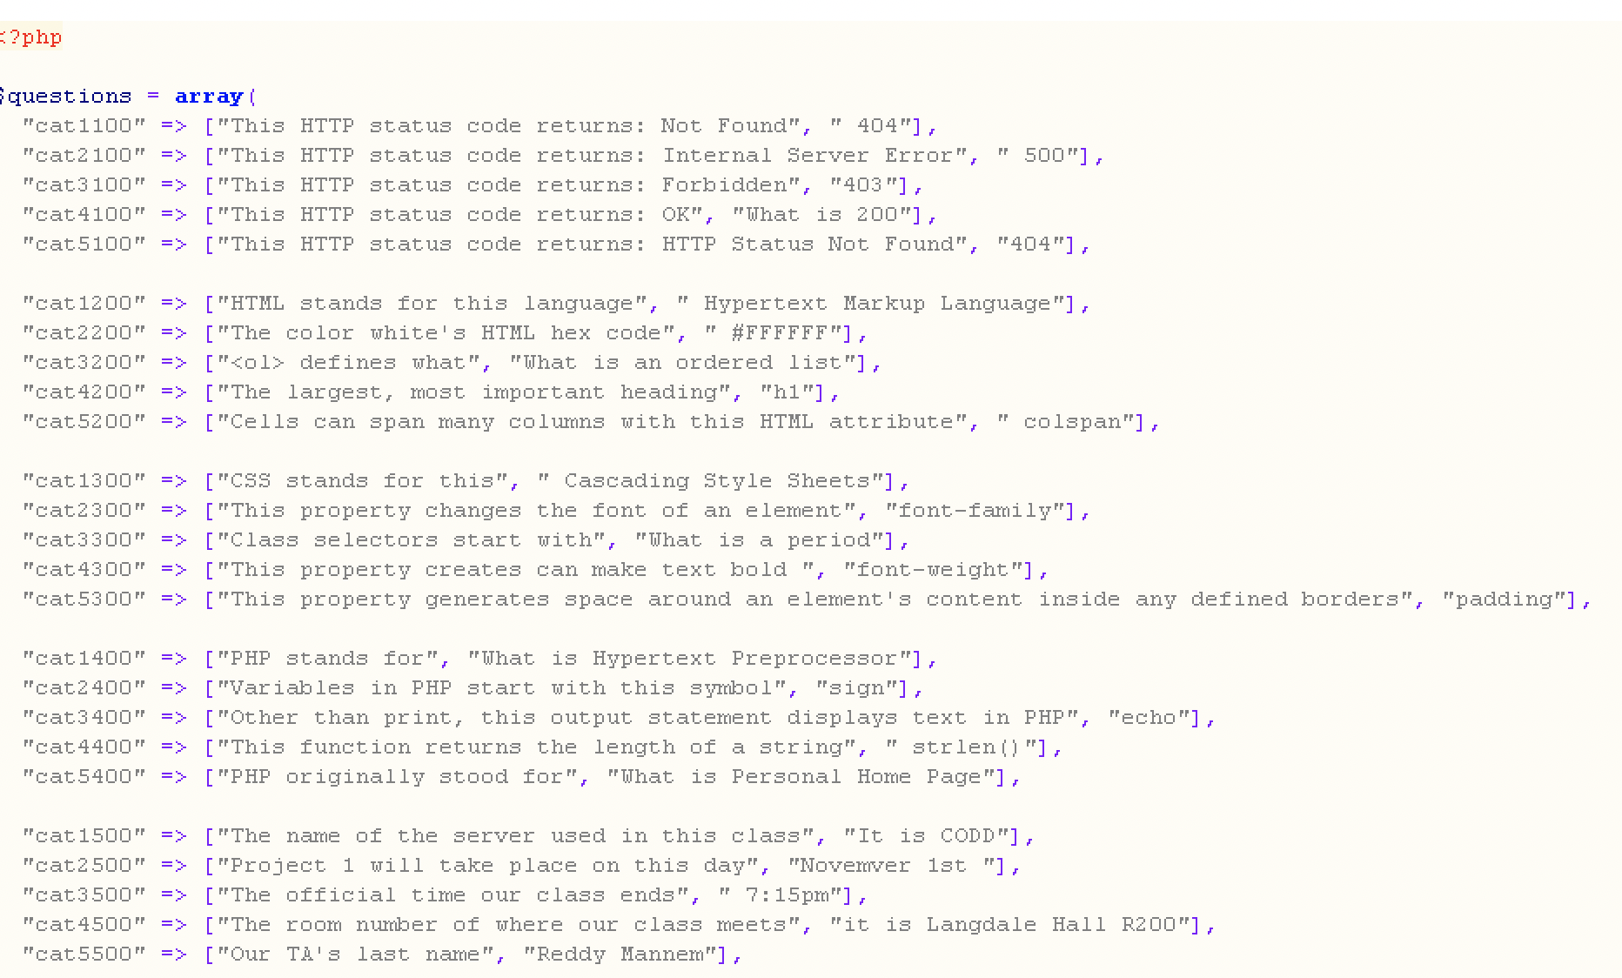
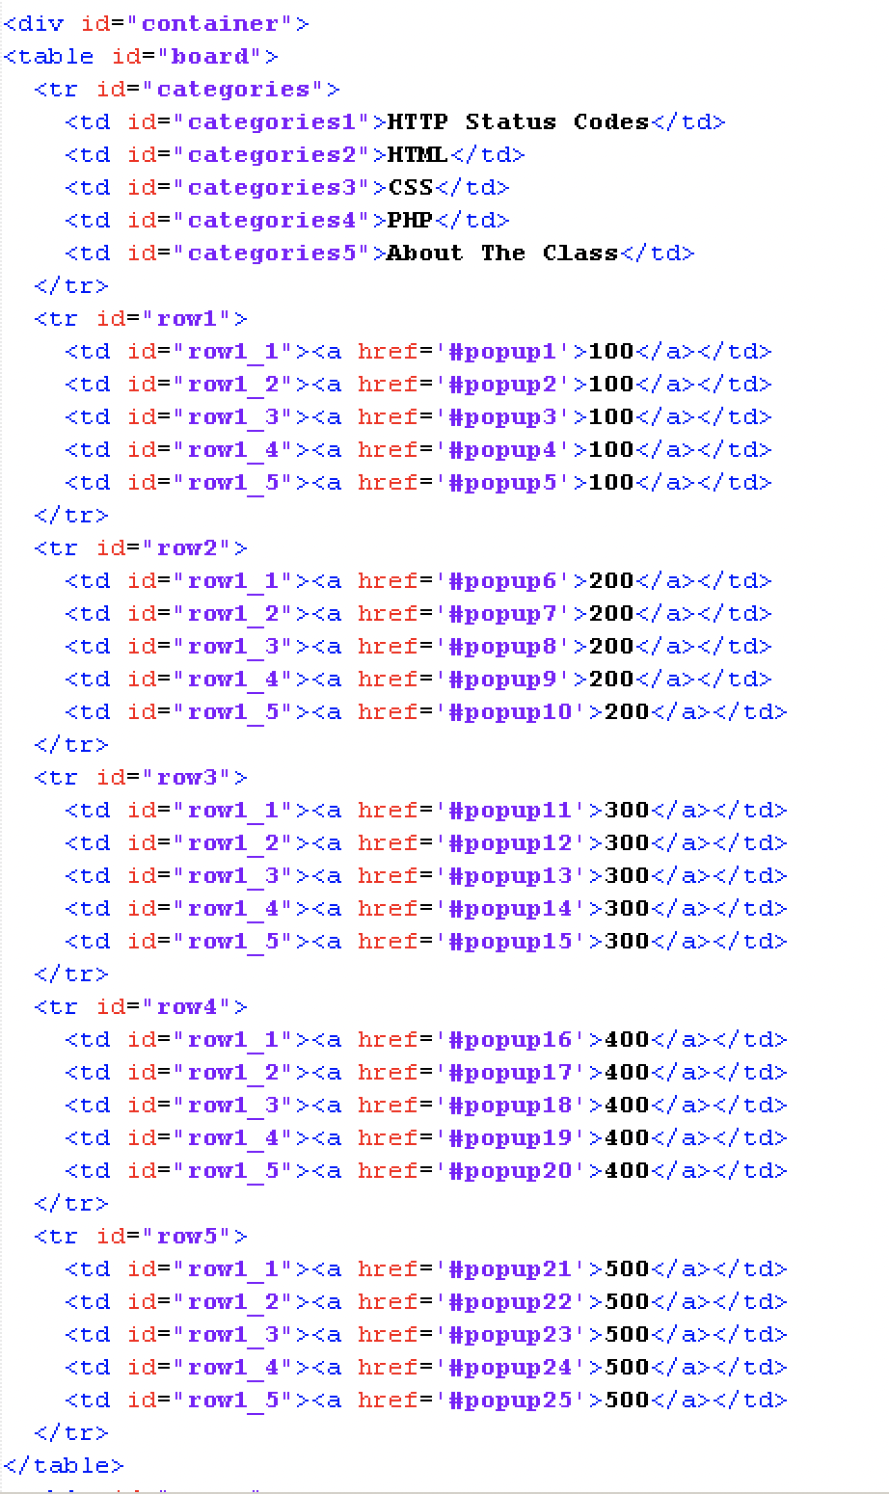
Board

Slide 8
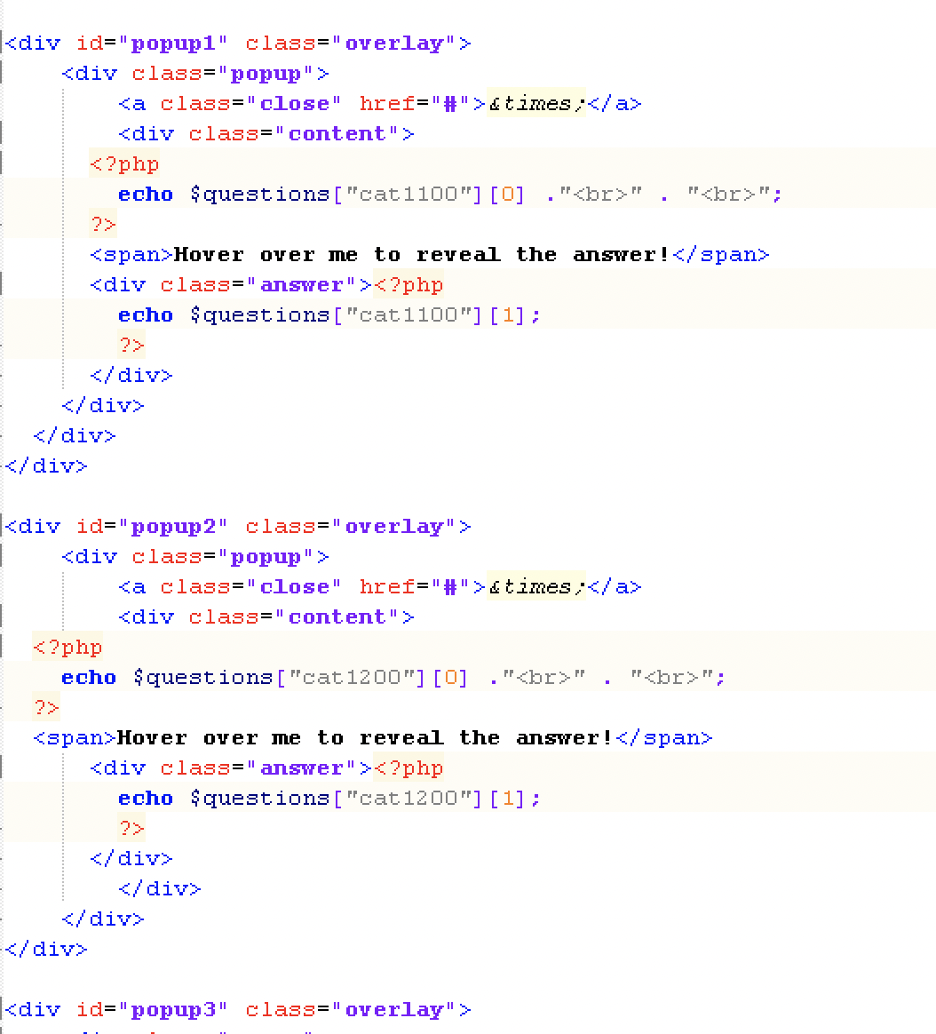
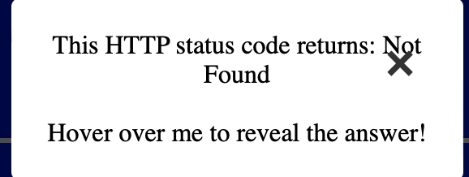
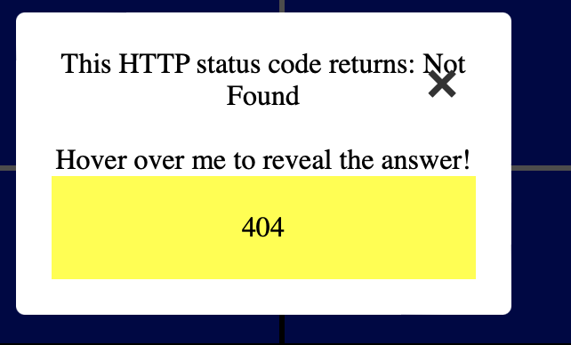
Question & Answer

Slide 9
Bugs
A user can manipulate their score by adding point onto their team.

Slide 10
Resolved Bugs
To resolve this issue we can add a point calculation system. We can change the operation of our work to implement a function that will make the user pick an answer, from there it would pop up a message to decide if they were right or wrong. It will use a function to decide if all the questions was pick and if it track more than the amount of questions then it would come out as false.

Slide 11
Benefits of Scrum Framework
Task Scheduling
Overall Teamwork
Knowing which files are completed
Less pressure

Slide 12
Time for the Demo

